Slide 1


CITS1003 Introduction to Cybersecurity [7] Security Assessment exercises
Dr Zhi Zhang

Slide 2
Project
The submission portal is available on LMS.
Download the latest answer sheet: https://github.com/uwacyber/cits1003/tree/2022s1/cits1003-project
Expression of Interest: Facilitating CITS1003 in Sem 1, 2027
https://forms.gle/TKcbdKo9RTcM4vYQA
Deadline is 11:59pm 13 July 2026.

Slide 3
Security Assessment
Attack Tree
Attack-Defense Tree

Slide 4
What is security assessment:
It is a process of evaluating the information-security posture of an organization’s information systems

Slide 5

Attack Tree
https://www.youtube.com/watch?v=rGljOEqLrjQ

Slide 6
Attack Tree
What is an attack tree?
It is a graphical structure of different paths that an attacker can take to achieve a specific attack goal.

Slide 7
Attack Tree
An attack tree has:
root node describes the goal of an attack
child node represents a sub-goal or an attack step for the overall goal
leaf node refers to an attack step and has no child node

Slide 8
Attack Tree
1 disable a web server
1.1 conduct a DDoS attack against the server
1.2 remotely shutdown the server
1.2.1 brute force the server's login credentials to gain an unauthorized access

Slide 9
Attack Tree
An attack tree has:
root node is the overall goal of the attack
child node represents a sub-goal or an attack step for the overall goal
leaf node refers to an attack step and has no child node
logical gate denotes the relationship among child nodes
OR gates: completing only one child node can lead to the completion of a parent node
AND gates:

Slide 10
Attack Tree
1 steal valuable items from a jewelry store
1.1 smash the display case and grab items
1.2 force a store employee to open the display case

Slide 11
Attack Tree
An attack tree has:
root node is the overall goal of the attack
child node represents a sub-goal or an attack step for the overall goal
leaf node refers to an attack step and has no child node
logical gate denotes the relationship among different nodes
OR gates: completing only one child node can lead to the completion of a parent node
AND gates: completing all child nodes so that a parent node can succeed

Slide 12
Attack Tree
1 gain an unauthorized access to a secure building
1.1 obtain a valid access card
1.2 steal the door passcode

Slide 13
Exercise
1. change students’ assessment marks in CITS1003 from LMS
1.1 gain direct access to the CITS1003’s marks database in LMS
1.1.1 exploit a software vulnerability in the LMS
1.2 log in as an authenticated UC
1.2.1 perform a brute-force login
1.2.1.1 identify the UC’s username
1.2.1.2 identify the UC’s password
1.2.2 steal the UC’s login credentials
1.3 hijack the web authentication session of the UC
1.3.1 steal the UC’s session cookie

Slide 14
Exercise
1. change students’ assessment marks in CITS1003 from LMS
1.1 gain direct access to the CITS1003’s marks database in LMS
1.1.1 exploit a software vulnerability in the LMS
1.2 log in as an authenticated UC
1.2.1 perform a brute-force login
1.2.1.1 identify the UC’s username
1.2.1.2 identify the UC’s password
1.2.2 steal the UC’s login credentials
1.3 hijack the web authentication session of the UC
1.3.1 steal the UC’s session cookie
OR

Slide 15
1 change students’ assessment marks in CITS1003 from LMS
1.1 gain direct access to the CITS1003’s marks database in LMS
1.2 log in as an authenticated UC
1.3 hijack the web authentication session of the UC

Slide 16
Exercise
1. change students’ assessment marks in CITS1003 from LMS
1.1 gain direct access to the CITS1003’s marks database in LMS
1.1.1 exploit a software vulnerability in the LMS
1.2 log in as an authenticated UC
1.2.1 perform a brute-force login
1.2.1.1 identify the UC’s username
1.2.1.2 identify the UC’s password
1.2.2 steal the UC’s login credentials
1.3 hijack the web authentication session of the UC
1.3.1 steal the UC’s session cookie
OR

Slide 17
Exercise
1. change students’ assessment marks in CITS1003 from LMS
1.1 gain direct access to the CITS1003’s marks database in LMS
1.1.1 exploit a software vulnerability in the LMS
1.2 log in as an authenticated UC
1.2.1 perform a brute-force login
1.2.1.1 identify the UC’s username
1.2.1.2 identify the UC’s password
1.2.2 steal the UC’s login credentials
1.3 hijack the web authentication session of the UC
1.3.1 steal the UC’s session cookie
OR
OR

Slide 18
1 change students’ assessment marks in CITS1003 from LMS
1.1 gain direct access to the CITS1003’s marks database in LMS
1.2 log in as an authenticated UC
1.3 hijack the web authentication session of the UC
1.1.1 exploit a software vulnerability in the LMS
1.2.1 perform a brute-force login
1.2.2 steal the UC’s login credentials
1.3.1 steal the UC’s session cookie

Slide 19
Exercise
1. change students’ assessment marks in CITS1003 from LMS
1.1 gain direct access to the CITS1003’s marks database in LMS
1.1.1 exploit a software vulnerability in the LMS
1.2 log in as an authenticated UC
1.2.1 perform a brute-force login
1.2.1.1 identify the UC’s username
1.2.1.2 identify the UC’s password
1.2.2 steal the UC’s login credentials
1.3 hijack the web authentication session of the UC
1.3.1 steal the UC’s session cookie
OR
OR

Slide 20
Exercise
1. change students’ assessment marks in CITS1003 from LMS
1.1 gain direct access to the CITS1003’s marks database in LMS
1.1.1 exploit a software vulnerability in the LMS
1.2 log in as an authenticated UC
1.2.1 perform a brute-force login
1.2.1.1 identify the UC’s username
1.2.1.2 identify the UC’s password
1.2.2 steal the UC’s login credentials
1.3 hijack the web authentication session of the UC
1.3.1 steal the UC’s session cookie
OR
OR
AND

Slide 21
1 change students’ assessment marks in CITS1003 from LMS
level-1
level-2
1.1 gain direct access to the CITS1003’s marks database in LMS
1.2 log in as an authenticated UC
1.3 hijack the web authentication session of the UC
level-3
1.1.1 exploit a software vulnerability in the LMS
1.2.1 perform a brute-force login
1.2.2 steal the UC’s login credentials
1.3.1 steal the UC’s session cookie
1.2.1.1 identify the UC’s username
1.2.1.2 identify the UC’s password
level-4

Slide 22
root node
1 change students’ assessment marks in CITS1003 from LMS
1.1 gain direct access to the CITS1003’s marks database in LMS
1.2 log in as an authenticated UC
1.3 hijack the web authentication session of the UC
1.1.1 exploit a software vulnerability in the LMS
1.2.1 perform a brute-force login
1.2.2 steal the UC’s login credentials
1.3.1 steal the UC’s session cookie
1.2.1.1 identify the UC’s username
1.2.1.2 identify the UC’s password

Slide 23
root node
1 change students’ assessment marks in CITS1003 from LMS
1.1 gain direct access to the CITS1003’s marks database in LMS
1.2 log in as an authenticated UC
1.3 hijack the web authentication session of the UC
1.1.1 exploit a software vulnerability in the LMS
1.2.1 perform a brute-force login
1.2.2 steal the UC’s login credentials
1.3.1 steal the UC’s session cookie
leaf node
1.2.1.1 identify the UC’s username
1.2.1.2 identify the UC’s password
leaf node

Slide 24
Attack Tree
How to evaluate the impact of an attack goal?
assign each leaf node a value and calculate the value for the root node
common practices for the assignment
probability of success represents the likelihood that a leaf node can be completed (e.g., 0 or 100%)
cost represents the expenses required to complete a leaf node (e.g., low, medium and high)

Slide 25
Possible or Impossible?
?
1 change students’ assessment marks in CITS1003 from LMS
level-1
?
?
?
level-2
1.1 gain direct access to the CITS1003’s marks database in LMS
1.2 log in as an authenticated UC
1.3 hijack the web authentication session of the UC
I
?
P
I
level-3
1.1.1 exploit a software vulnerability in the LMS
1.2.1 perform a brute-force login
1.2.2 steal the UC’s login credentials
1.3.1 steal the UC’s session cookie
P
I
1.2.1.1 identify the UC’s username
1.2.1.2 identify the UC’s password
level-4

Slide 26
Possible or Impossible?
?
1 change students’ assessment marks in CITS1003 from LMS
level-1
?
?
?
level-2
1.1 gain direct access to the CITS1003’s marks database in LMS
1.2 log in as an authenticated UC
1.3 hijack the web authentication session of the UC
I
P
I
level-3
I
1.1.1 exploit a software vulnerability in the LMS
1.2.1 perform a brute-force login
1.2.2 steal the UC’s login credentials
1.3.1 steal the UC’s session cookie
P
I
1.2.1.1 identify the UC’s username
1.2.1.2 identify the UC’s password
level-4

Slide 27
Possible or Impossible?
?
1 change students’ assessment marks in CITS1003 from LMS
level-1
I
?
?
level-2
1.1 gain direct access to the CITS1003’s marks database in LMS
1.2 log in as an authenticated UC
1.3 hijack the web authentication session of the UC
I
P
I
level-3
I
1.1.1 exploit a software vulnerability in the LMS
1.2.1 perform a brute-force login
1.2.2 steal the UC’s login credentials
1.3.1 steal the UC’s session cookie
P
I
1.2.1.1 identify the UC’s username
1.2.1.2 identify the UC’s password
level-4

Slide 28
Possible or Impossible?
?
1 change students’ assessment marks in CITS1003 from LMS
level-1
I
?
I
level-2
1.1 gain direct access to the CITS1003’s marks database in LMS
1.2 log in as an authenticated UC
1.3 hijack the web authentication session of the UC
I
P
I
level-3
I
1.1.1 exploit a software vulnerability in the LMS
1.2.1 perform a brute-force login
1.2.2 steal the UC’s login credentials
1.3.1 steal the UC’s session cookie
P
I
1.2.1.1 identify the UC’s username
1.2.1.2 identify the UC’s password
level-4

Slide 29
Possible or Impossible?
?
1 change students’ assessment marks in CITS1003 from LMS
level-1
I
P
I
level-2
1.1 gain direct access to the CITS1003’s marks database in LMS
1.2 log in as an authenticated UC
1.3 hijack the web authentication session of the UC
I
P
I
level-3
I
1.1.1 exploit a software vulnerability in the LMS
1.2.1 perform a brute-force login
1.2.2 steal the UC’s login credentials
1.3.1 steal the UC’s session cookie
P
I
1.2.1.1 identify the UC’s username
1.2.1.2 identify the UC’s password
level-4

Slide 30
Possible or Impossible?
P
1 change students’ assessment marks in CITS1003 from LMS
level-1
I
P
I
level-2
1.1 gain direct access to the CITS1003’s marks database in LMS
1.2 log in as an authenticated UC
1.3 hijack the web authentication session of the UC
I
P
I
level-3
I
1.1.1 exploit a software vulnerability in the LMS
1.2.1 perform a brute-force login
1.2.2 steal the UC’s login credentials
1.3.1 steal the UC’s session cookie
P
I
1.2.1.1 identify the UC’s username
1.2.1.2 identify the UC’s password
level-4

Slide 31
Calculate attack cost?
?
1 change students’ assessment marks in CITS1003 from LMS
level-1
level-2
?
?
?
1.1 gain direct access to the CITS1003’s marks database in LMS
1.2 log in as an authenticated UC
1.3 hijack the web authentication session of the UC
level-3
$200
?
$400
$50
1.1.1 exploit a software vulnerability in the LMS
1.2.1 perform a brute-force login
1.2.2 steal the UC’s login credentials
1.3.1 steal the UC’s session cookie
$5
$50
1.2.1.1 identify the UC’s username
1.2.1.2 identify the UC’s password
level-4

Slide 32
Calculate attack cost?
?
1 change students’ assessment marks in CITS1003 from LMS
level-1
level-2
?
?
?
1.1 gain direct access to the CITS1003’s marks database in LMS
1.2 log in as an authenticated UC
1.3 hijack the web authentication session of the UC
level-3
$200
$55
$400
$50
1.1.1 exploit a software vulnerability in the LMS
1.2.1 perform a brute-force login
1.2.2 steal the UC’s login credentials
1.3.1 steal the UC’s session cookie
$5
$50
1.2.1.1 identify the UC’s username
1.2.1.2 identify the UC’s password
level-4

Slide 33
Calculate attack cost?
?
1 change students’ assessment marks in CITS1003 from LMS
level-1
level-2
$200
?
?
1.1 gain direct access to the CITS1003’s marks database in LMS
1.2 log in as an authenticated UC
1.3 hijack the web authentication session of the UC
level-3
$200
$55
$400
$50
1.1.1 exploit a software vulnerability in the LMS
1.2.1 perform a brute-force login
1.2.2 steal the UC’s login credentials
1.3.1 steal the UC’s session cookie
$5
$50
1.2.1.1 identify the UC’s username
1.2.1.2 identify the UC’s password
level-4

Slide 34
Calculate attack cost?
?
1 change students’ assessment marks in CITS1003 from LMS
level-1
level-2
$200
?
$50
1.1 gain direct access to the CITS1003’s marks database in LMS
1.2 log in as an authenticated UC
1.3 hijack the web authentication session of the UC
level-3
$200
$55
$400
$50
1.1.1 exploit a software vulnerability in the LMS
1.2.1 perform a brute-force login
1.2.2 steal the UC’s login credentials
1.3.1 steal the UC’s session cookie
$5
$50
1.2.1.1 identify the UC’s username
1.2.1.2 identify the UC’s password
level-4

Slide 35
Calculate attack cost?
?
1 change students’ assessment marks in CITS1003 from LMS
level-1
level-2
$200
$55
$50
1.1 gain direct access to the CITS1003’s marks database in LMS
1.2 log in as an authenticated UC
1.3 hijack the web authentication session of the UC
level-3
$200
$55
$400
$50
1.1.1 exploit a software vulnerability in the LMS
1.2.1 perform a brute-force login
1.2.2 steal the UC’s login credentials
1.3.1 steal the UC’s session cookie
$5
$50
1.2.1.1 identify the UC’s username
1.2.1.2 identify the UC’s password
level-4

Slide 36
Calculate attack cost?
$50
1 change students’ assessment marks in CITS1003 from LMS
level-1
level-2
$200
$55
$50
1.1 gain direct access to the CITS1003’s marks database in LMS
1.2 log in as an authenticated UC
1.3 hijack the web authentication session of the UC
level-3
$200
$55
$400
$50
1.1.1 exploit a software vulnerability in the LMS
1.2.1 perform a brute-force login
1.2.2 steal the UC’s login credentials
1.3.1 steal the UC’s session cookie
$5
$50
1.2.1.1 identify the UC’s username
1.2.1.2 identify the UC’s password
level-4

Slide 37
Attack-Defense Tree
What is an attack-defense tree?
It is also a graphical structure that extends an attack tree. The root typically represents the attacker’s main goal. The tree represents attacks to be carried out and corresponding defenses that can mitigate the attacks.
ADTool: short for Attack-Defense Tree Tool, allowing a user to analyze attack-defense scenarios using attack-defense trees.

Slide 38
ADTool
Installation
In a windows OS, download JDK (Java Development Kit):
Filename: jdk-17.0.18_windows-x64_bin.exe
Download the exe file: https://www.oracle.com/java/technologies/downloads/
Install JDK
Double click the exe file

Slide 39
ADTool
Installation
Download JDK
Install JDK
Download ADTool: https://satoss.uni.lu/members/piotr/adtool/
Filename: ADTool-1.4-jar-with-dependencies.jar

Slide 40
ADTool
Installation
Download JDK
Download ADTool
Run the tool
Open PowerShell and change into the directory where the tool is downloaded
Run this command: java –jar .\ADTool-1.4-jar-with-dependencies.jar

Slide 41
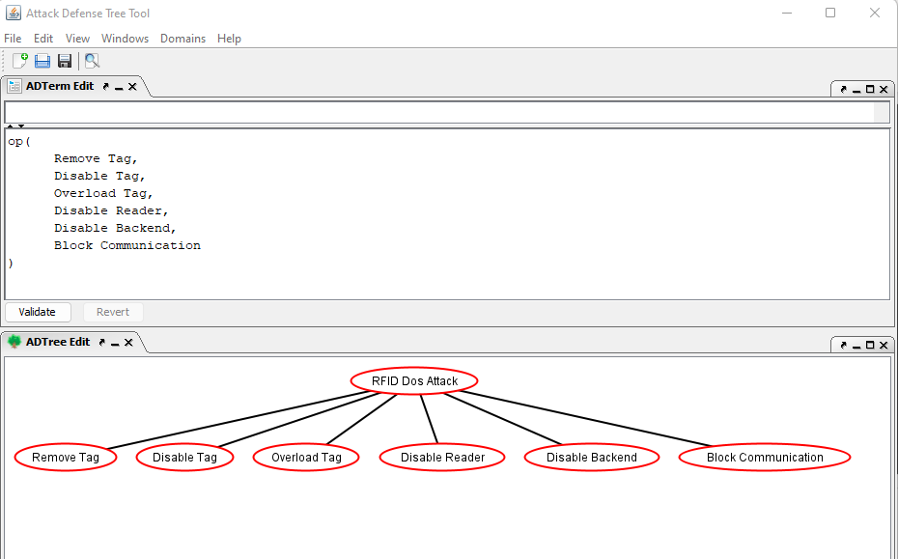

Slide 42
or proponents

Slide 43
or proponents
or
proponents

Slide 45
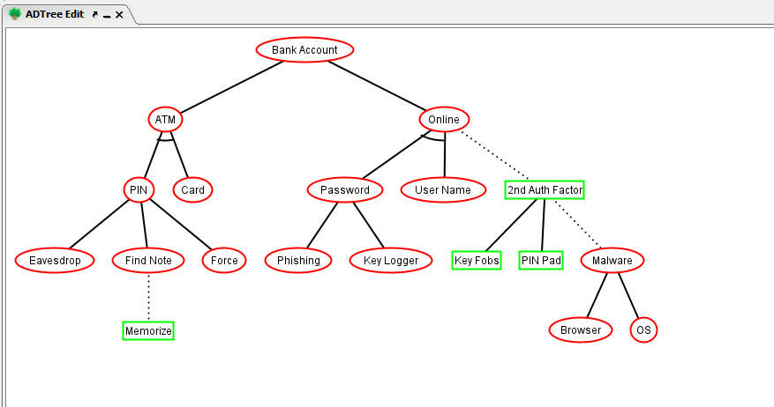
or proponents
op
op
op

Slide 46
op: or proponents
ap: and proponents
ap
?
op
op
?
?
op
?

Slide 47
op: or proponents
ap: and proponents
ap
?
opponent
op
op
oo: or opponents
?
opponent
opponent
op
?
opponent

Slide 48
op: or proponents
ap: and proponents
ap
cp
opponent
op
op
oo: or opponent
co: counter opponent
opponent
opponent
op
cp: counter proponent
opponent

Slide 49
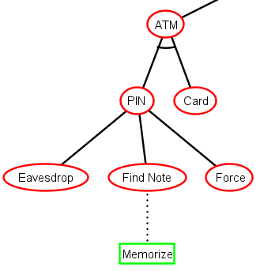
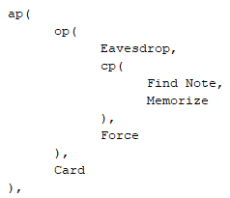

Slide 50
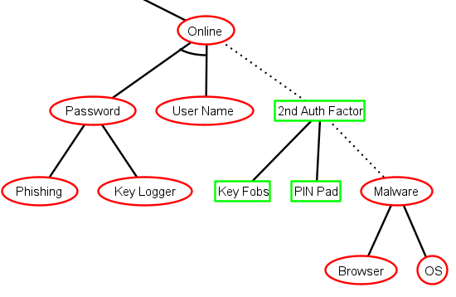
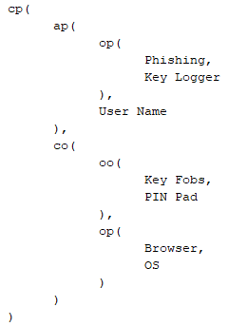

Slide 51
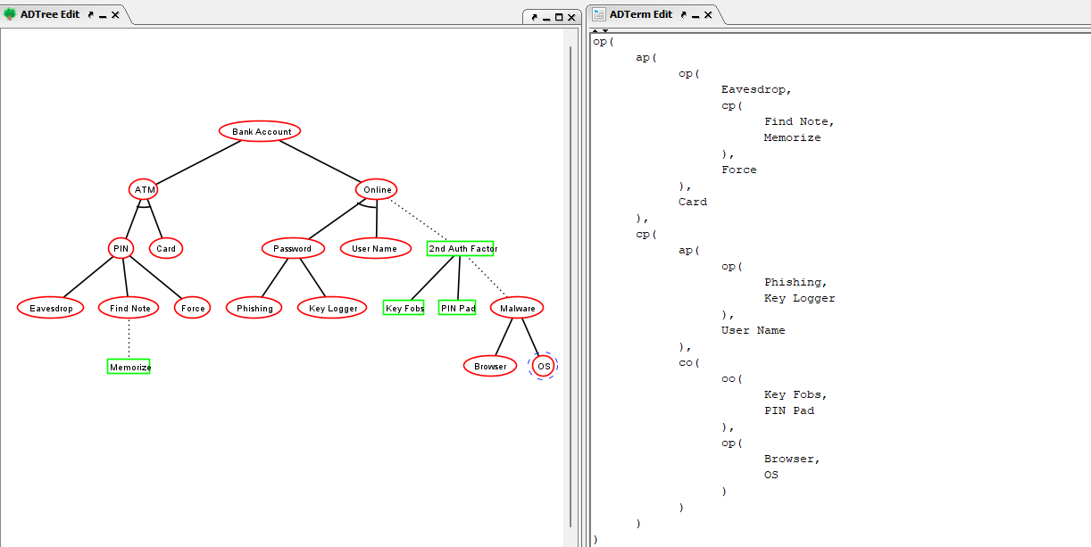

Slide 52
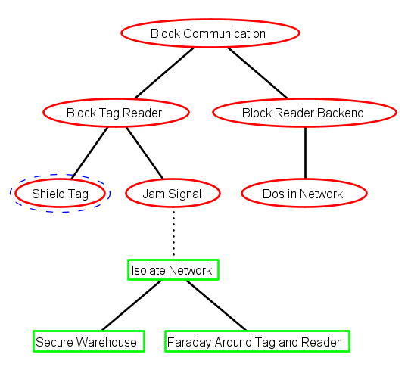
Exercise (tree translation)

Slide 53
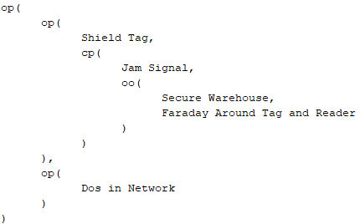
Exercise (tree translation)

Slide 54
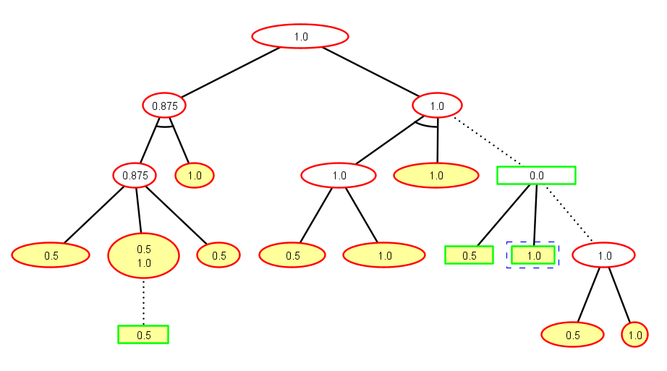
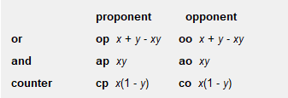
Exercise (success probability for the nodes)
0.75
1.0
0.0
1.0
0.5

Slide 55
Exercise (success probability for the nodes)
0.75
1.0
0.0
1.0
0.5

Slide 56
Exercise (success probability for the nodes)
0.75
1.0
0.0
1.0
0.5

Slide 57
Exercise (success probability for the nodes)
0.75
1.0
0.0
1.0
0.75
0.5

Slide 58
Exercise (success probability for the nodes)
0.75
1.0
0.0
0.75+0.5-0.75*0.5
1.0
0.5

Slide 59
Exercise (success probability for the nodes)
0.75
1.0
0.0
0.75+0.5-0.75*0.5
1.0
0.5

Slide 60
Exercise (success probability for the nodes)
0.75
1.0
0.25
0.75+0.5-0.75*0.5
1.0
0.75
0.5

Slide 61
Exercise (success probability for the nodes)
0.75
1.0
0.0
0.75+0.5-0.75*0.5
1.0
0.75
0.5

Slide 62
Exercise (success probability for the nodes)
0.75
1.0
0.0
0.75+0.5-0.75*0.5
1.0
0.75
0.5

Slide 63
Exercise (success probability for the nodes)
0.75
1.0
0.25
0.75+0.5-0.75*0.5
1.0
0.75
0.5

Slide 64
Exercise (success probability for the nodes)
0.75
1.0
0.25
0.75+0.5-0.75*0.5
1.0
0.75
0.5

Slide 65
Exercise (success probability for the nodes)
0.75
1.0
0.25
0.75+0.5-0.75*0.5
1.0
0.75
0.5

Slide 66
Exercise (success probability for the nodes)
0.875+0.75-0.875*0.75
0.96875
0.75
1.0
0.25
0.75+0.5-0.75*0.5
1.0
0.75
0.5

